Slide 1
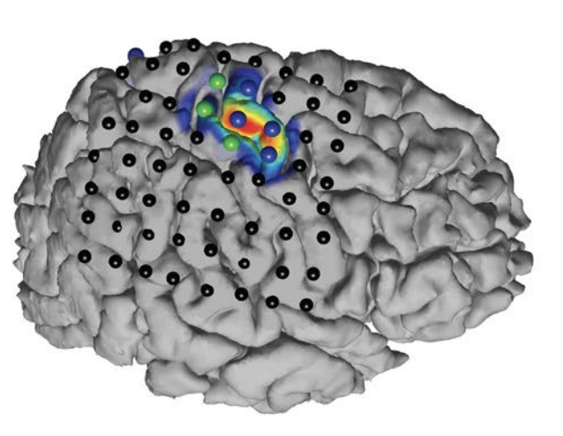
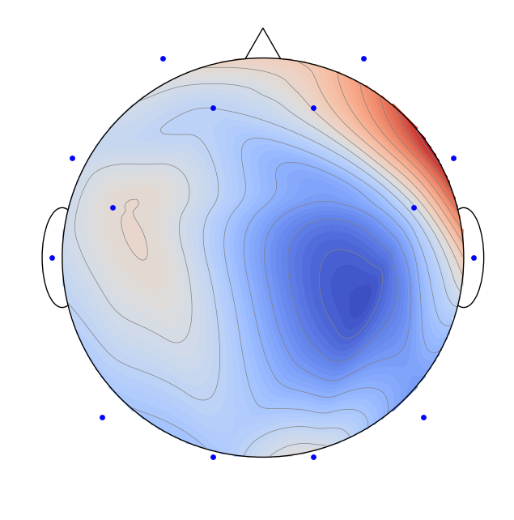
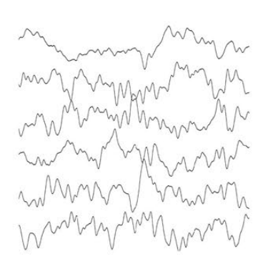
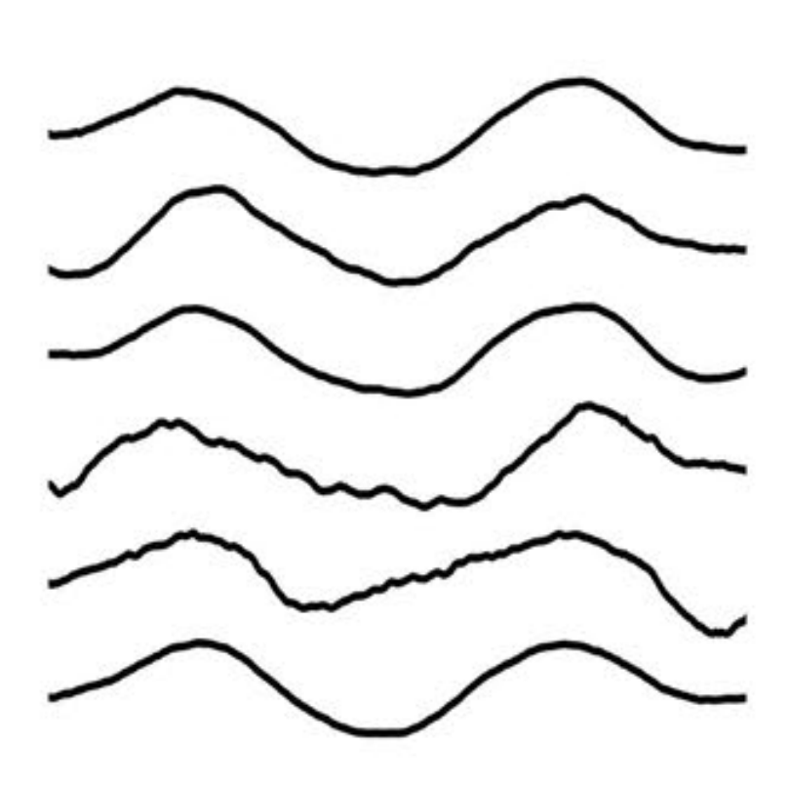
Spatial Filtering for Source Separation in EEG Data
Christian Endl, Felix Wirth, Korbinian Kunst & Taulant Koka

Slide 2
Agena
Graph Blind Source Separation results
Summary of major outcomes
Problems and future research

Slide 3
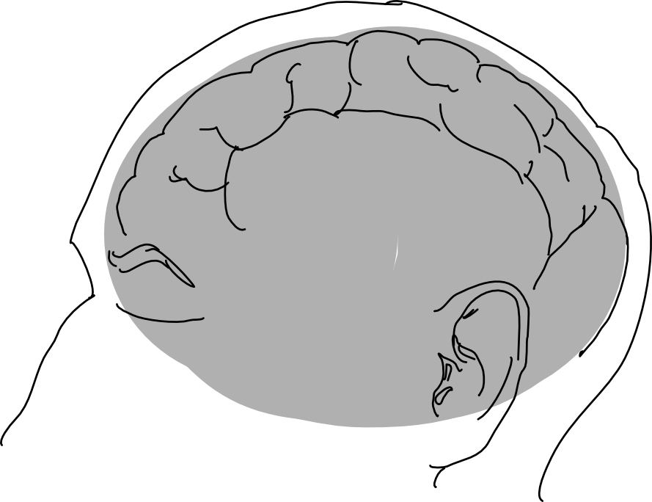
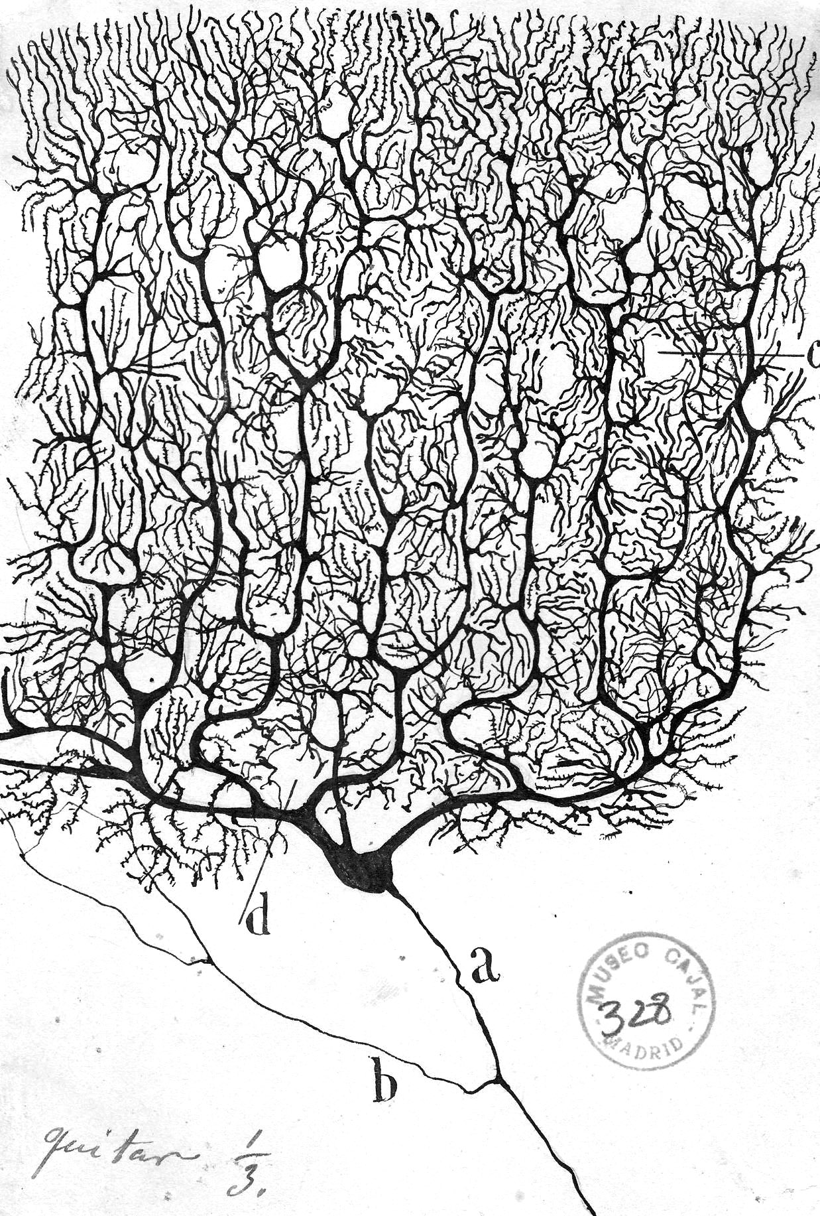
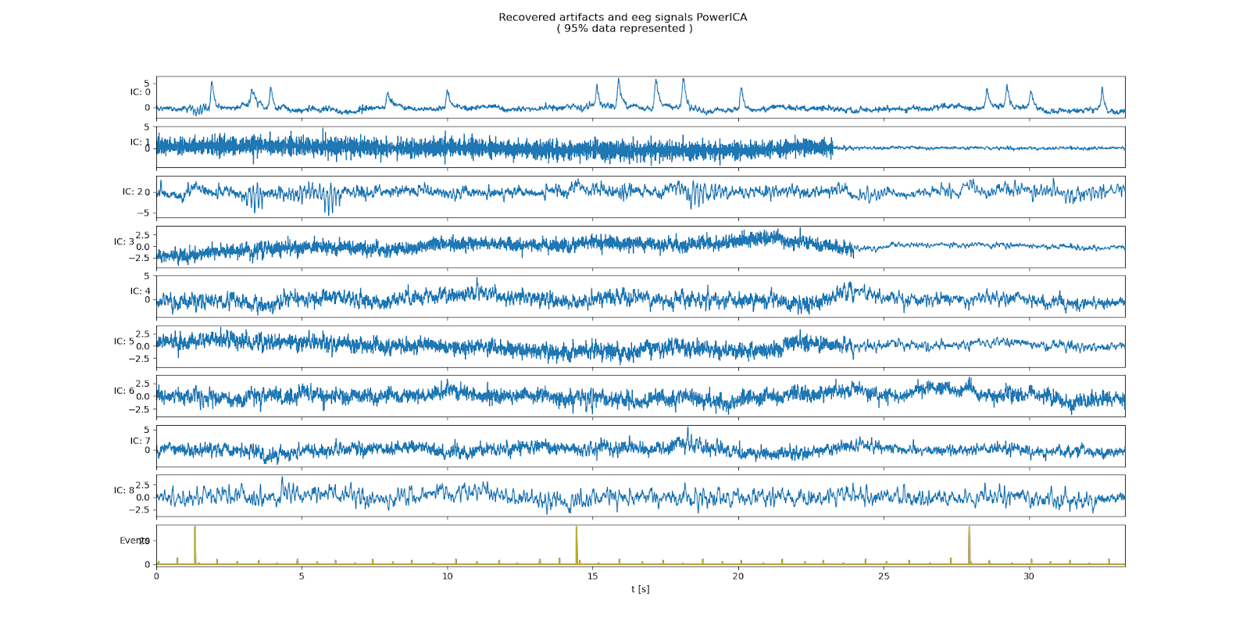
Motivation Challenge of Working with EEG Data
Electroencephalogram (EEG) Concept
What we wish to have?
We are observing the "oscillating slow fields" of neurons in the upper layers of the cerebral cortex.
These changes in electrical potential lead a neuron to be more likely or less likely to fire action potentials and are important in encoding information in the brain.
What do we get in experiments?
“
Working with EEG data is
therefore the process of source separation
EEG Channels
time t in seconds

Slide 4

The Concept of Source Seperation Cocktail Party Problem

Slide 5

The Concept of Source Seperation Cocktail Party Problem

Slide 6


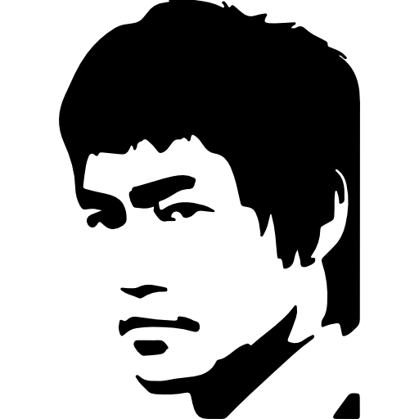

The Concept of Source Saperation Cocktail Party Problem

Slide 7
The Concept of Source Seperation Cocktail Party Problem
Original Signals
Sensors
Reconstructed Signals
Latent Variables
Observed Data
Result of the Source Seperation

Slide 8

The Concept of Source Seperation Cocktail Party Problem
Original Signals
Overlay of Signals
Sensors
Latent Variables
Mixing Matrix
Observed Data
$$s W x$$

Slide 9
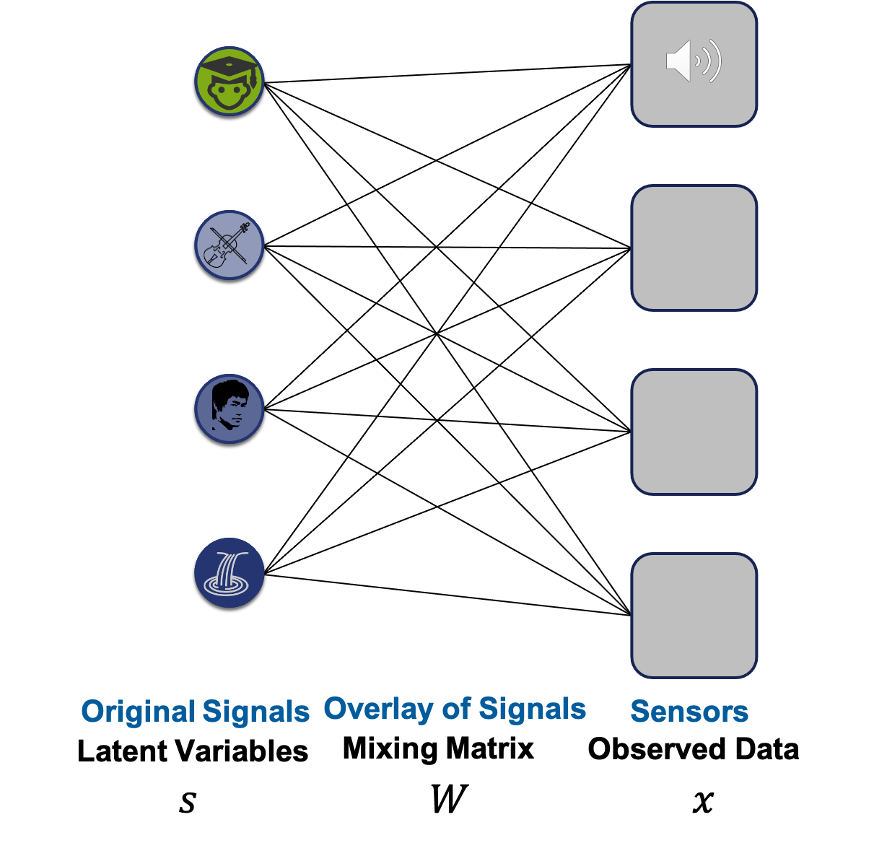

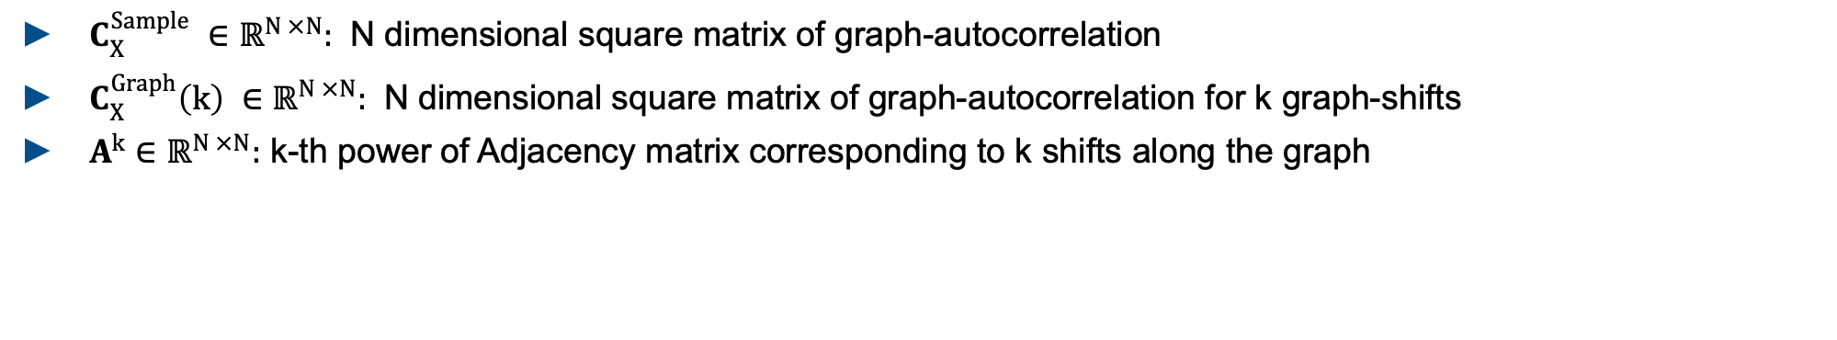
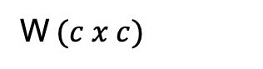
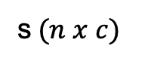
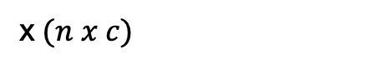
The Concept of Source Separation Cocktail Party Problem
$$s W=x$$
s$(n x c)$
W$(c x c)$
x$(n x c)$
$C_{X}^{Sample} ∈{\text{ℝ}}^{N ×N}:$ N dimensional square matrix of graph-autocorrelation
$C_{X}^{Graph}\left(k\right) ∈{\text{ℝ}}^{N ×N}:$ N dimensional square matrix of graph-autocorrelation for k graph-shifts
$A^{k}∈{\text{ℝ}}^{N ×N}:$ k-th power of Adjacency matrix corresponding to k shifts along the graph

Slide 10
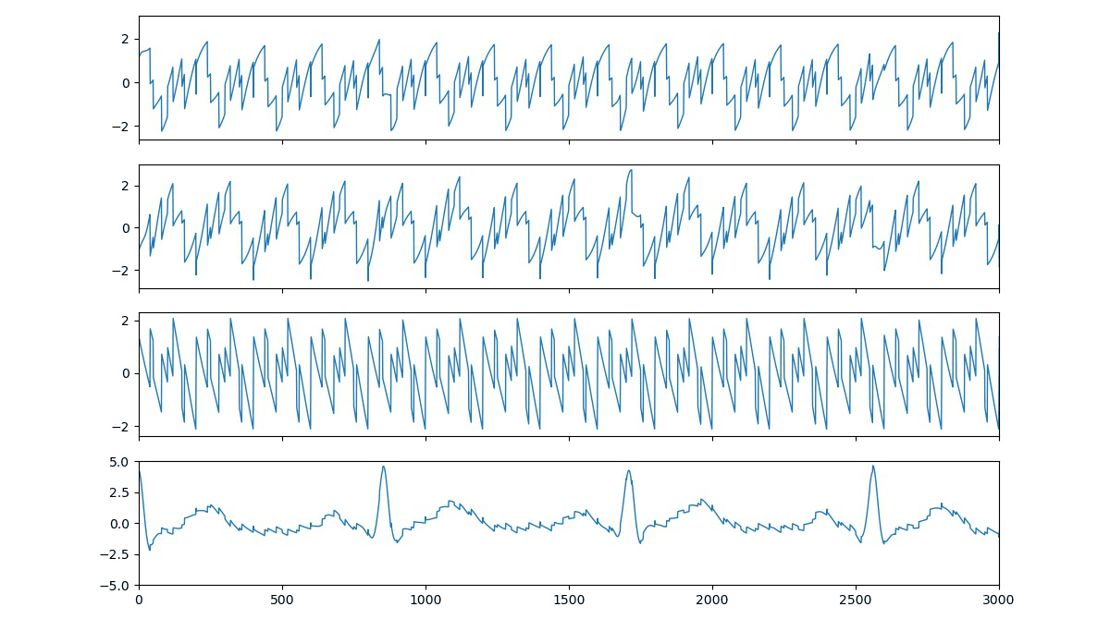
ICA Signal Reconstruction From Mixed Example Signals to Deconstructed Signals

